Slide 1
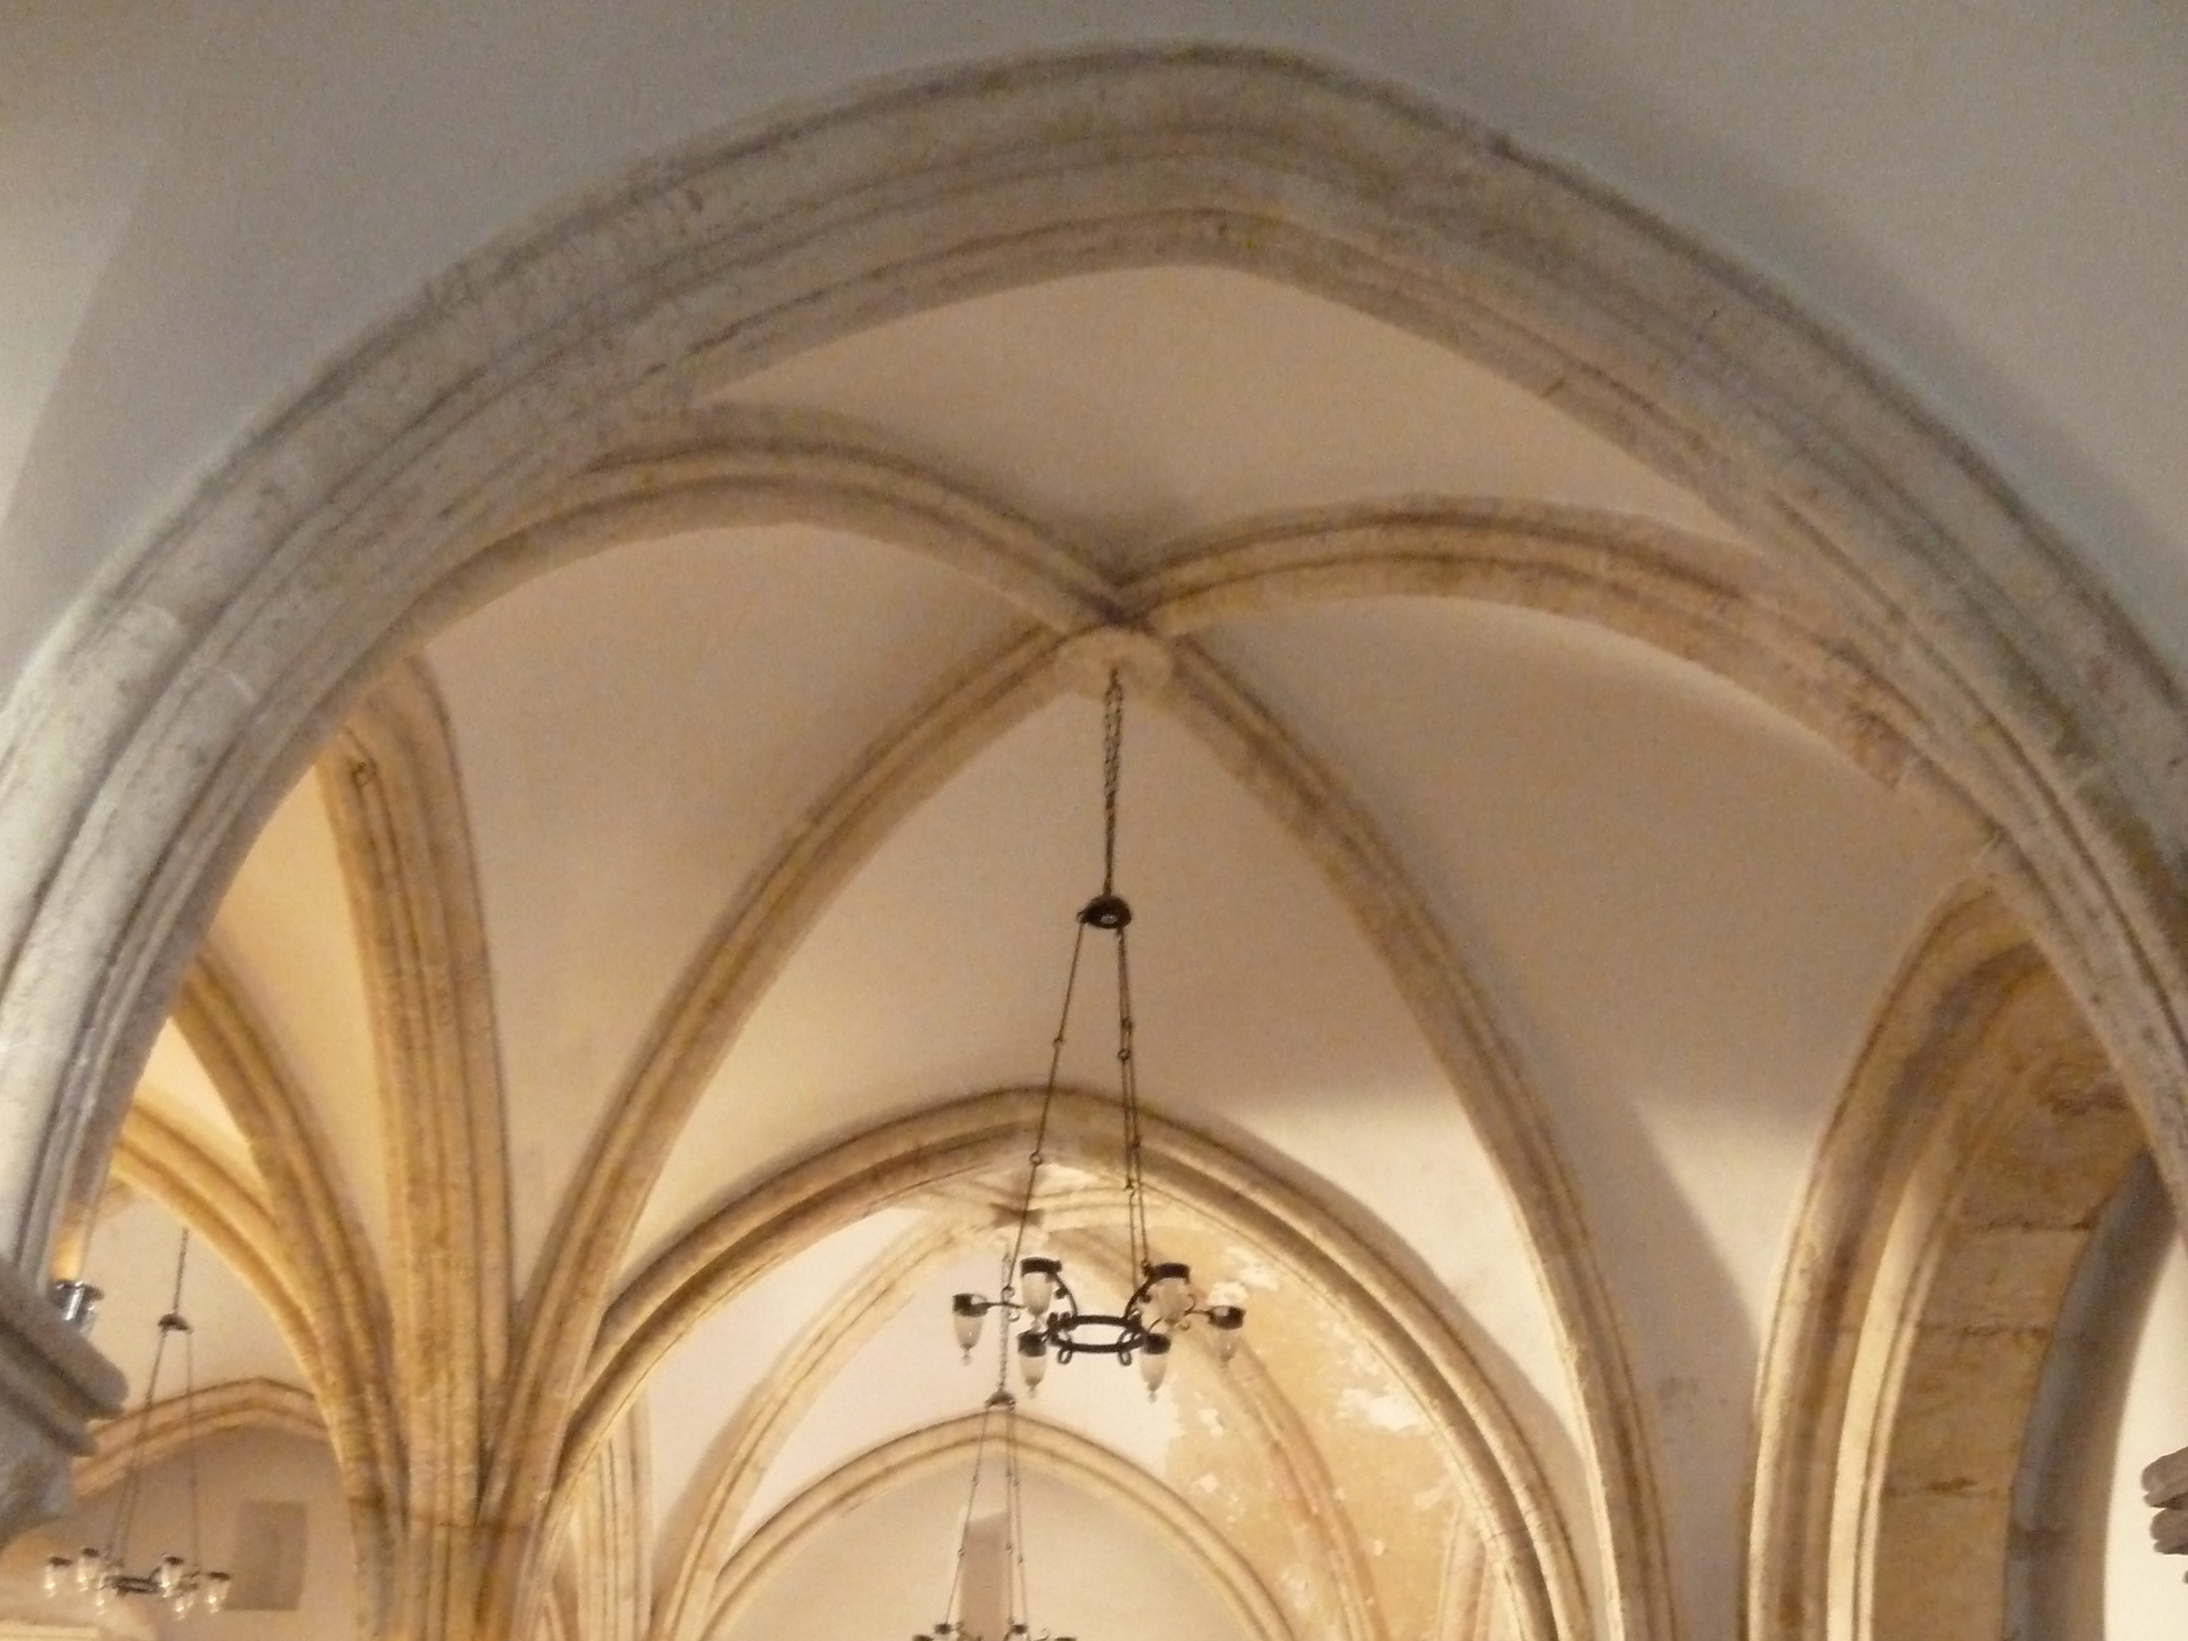
John 13.1-17

Slide 2
John 13.1 NET: Just before the Passover feast, Jesus knew that his time had come to depart from this world to the Father. Having loved his own who were in the world,
he now loved them
to the very end.
μεταβαίνω = to pass over / to transfer from one place to another / to move from death to life [John 5.24]

Slide 3
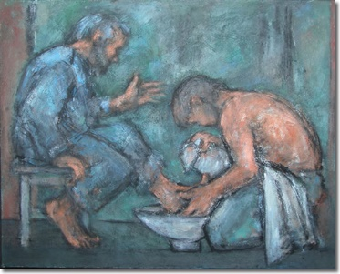
because Satan corrupted Judas, because Jesus knew his
identity, destination, and authority, he got up and dressed like a slave…
photo by Ghislaine Howard; taken from Methodist.org.uk

Slide 4
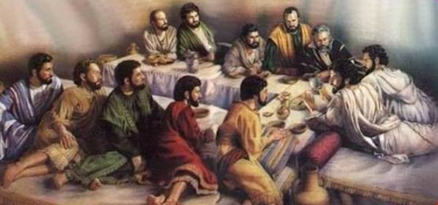
photo taken from beit-el.blogspot.com
“Lord, are you washing my feet?”

Slide 5
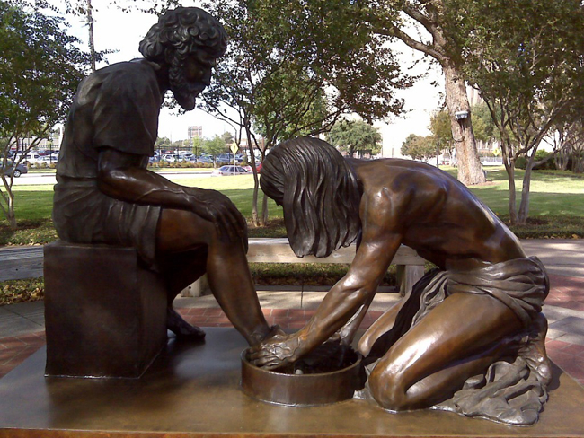
photo taken from thewellcommunity.org

Slide 6
“If I do not wash you, you do not have a
share with me.”
inheritance or
end times blessings = eternity with Jesus

Slide 7
“If I do not wash you, you do not have a share with me.”
Justification = declared righteous/pure
Sanctification = made righteous/pure

Slide 8
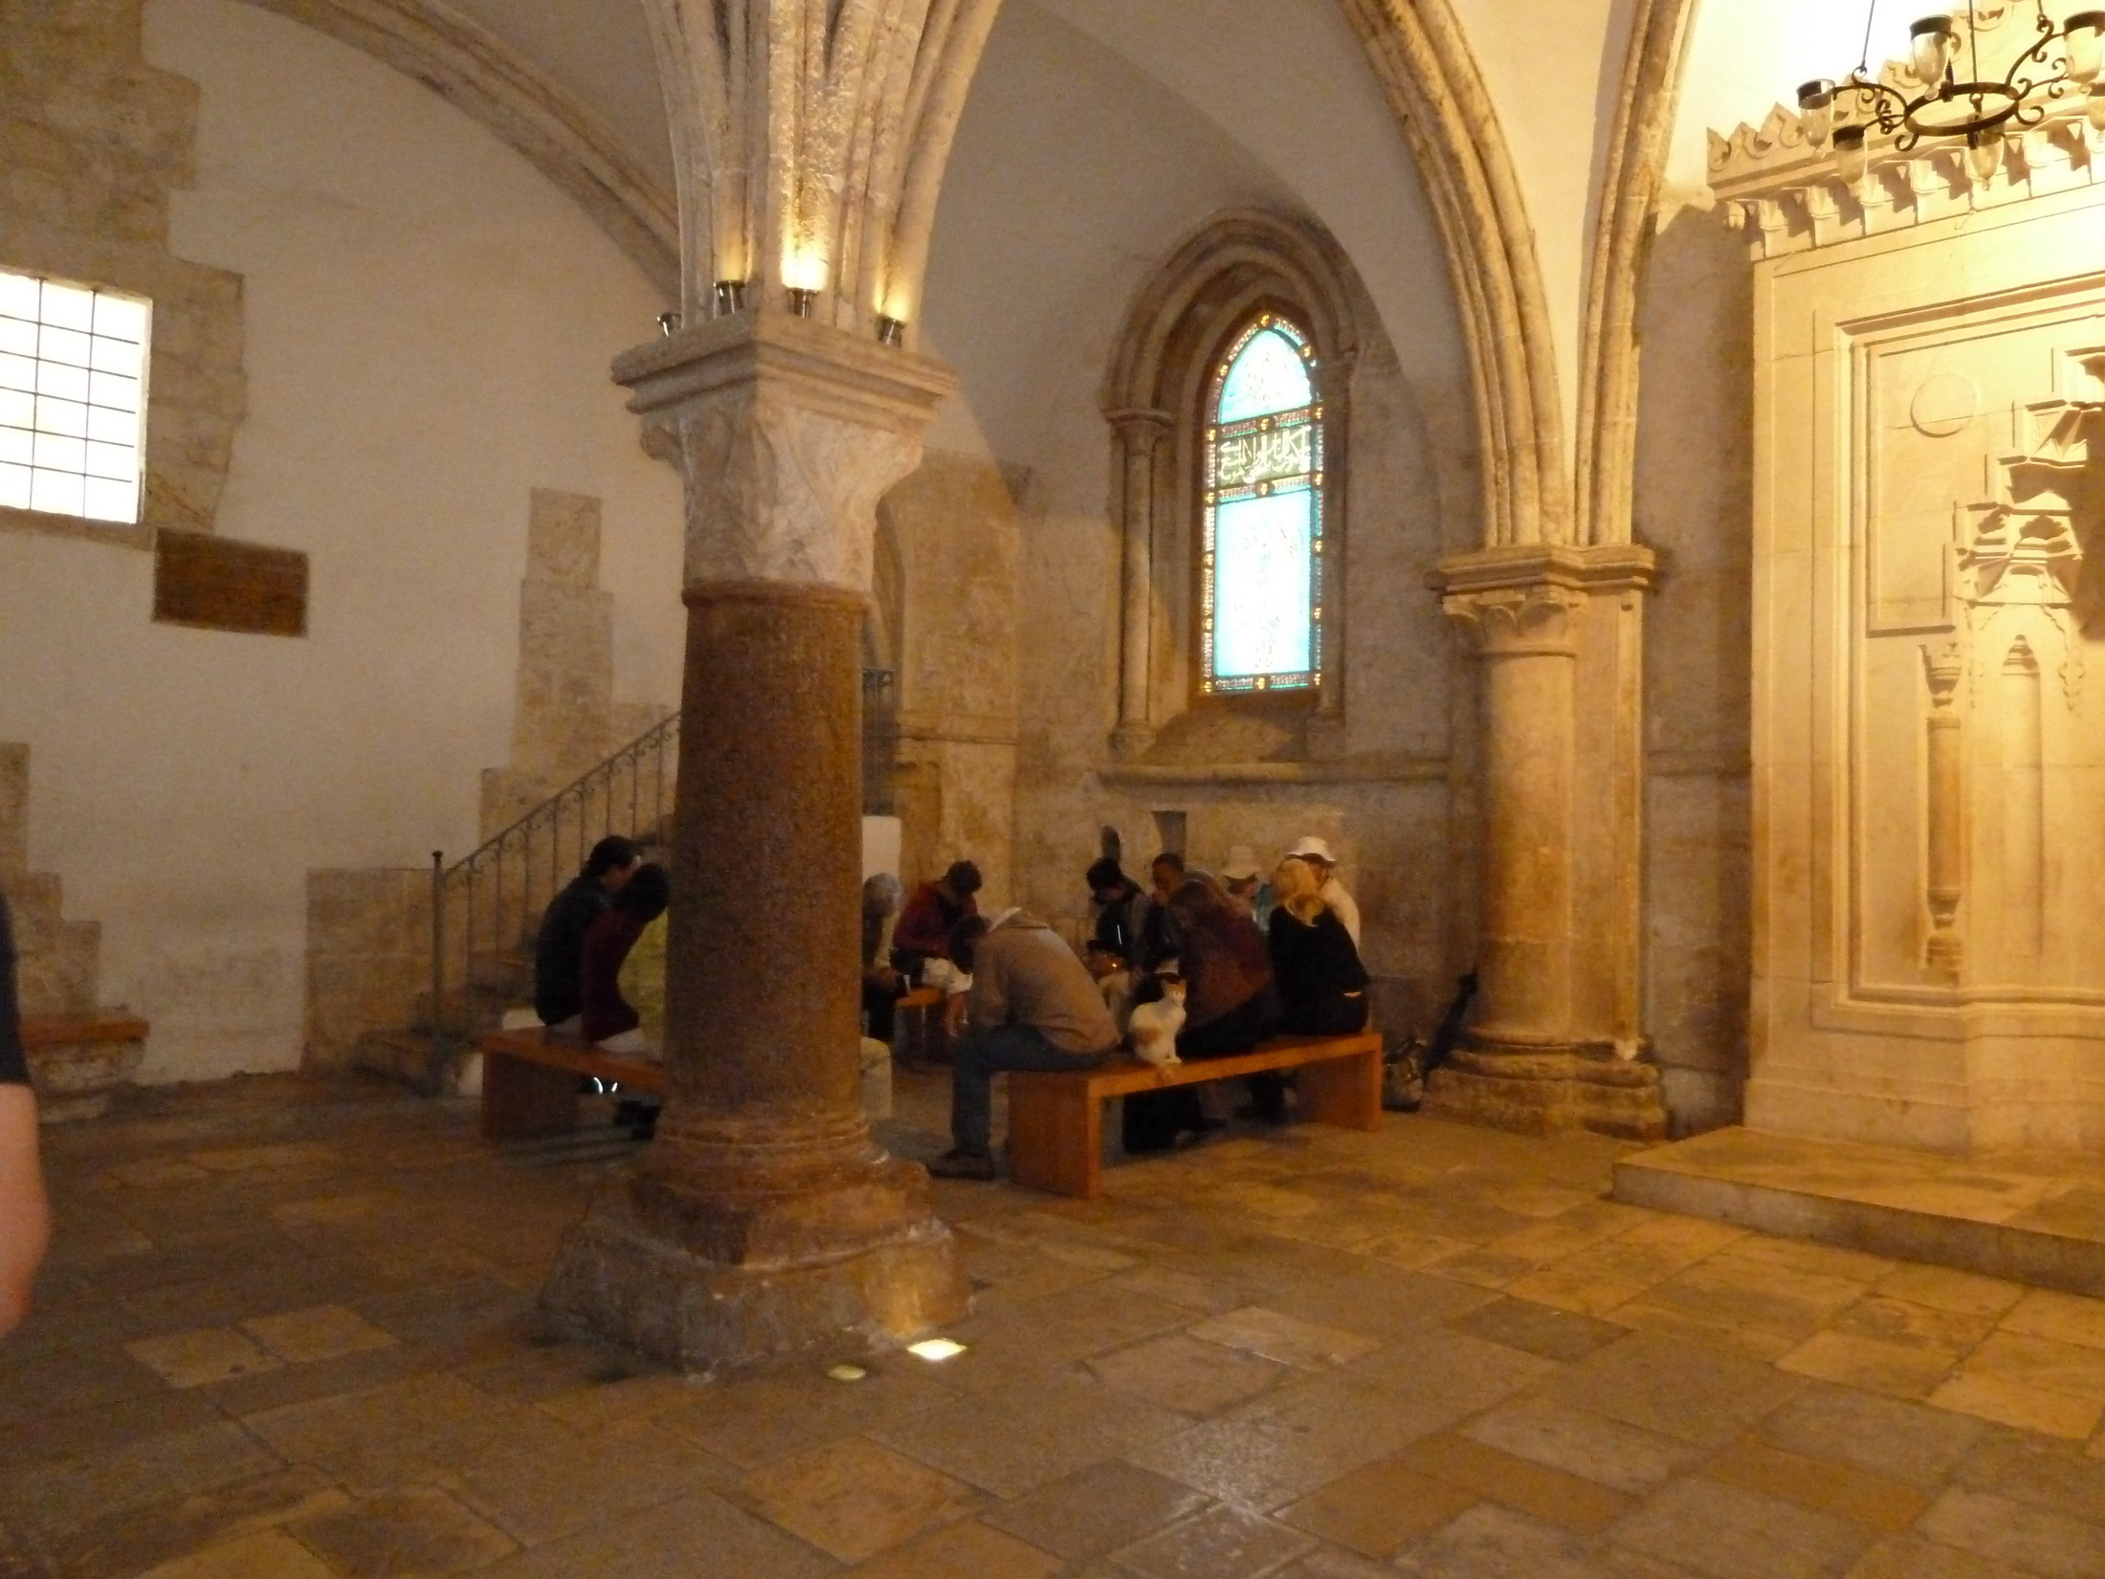
“The one who has bathed needs only to wash his feet, but is completely clean…
Do you understand what I have done for you?”

Slide 9
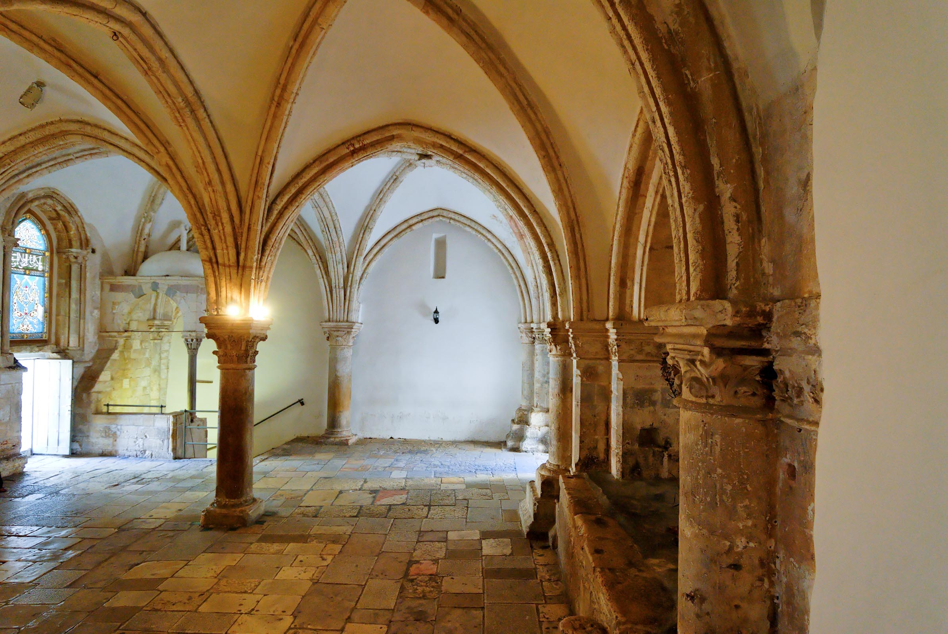
“I tell you the solemn truth, = ἀμὴν ἀμὴν = truly truly
the slave is not greater than his master, nor is the one who is sent as a messenger greater than the one who sent him.” ἀπόστολος = apostle
photo © 2012 Todd Bolen
BiblePlaces.com

Slide 10
“If I then, your Lord and Teacher, have washed your feet, you too ought to wash one another's feet. For I have given you an example– you should do just as I have done for you.”
photo © 2012 Todd Bolen
BiblePlaces.com

Slide 11
“If you understand these things,
you will be blessed if you do them.”
photo © 2012 Todd Bolen
BiblePlaces.com

Slide 12
Christ died to cleanse us, in God’s eyes and experientially.
Foot washing symbolized what Jesus offers through the cross.
We have to accept the cleansing of Christ.
Ongoing cleansing comes through repentant confession of our sins.
We are to follow the example of Jesus, to be so humble and sacrificial in serving others, that we live to bless them and would die for them.

Slide 13
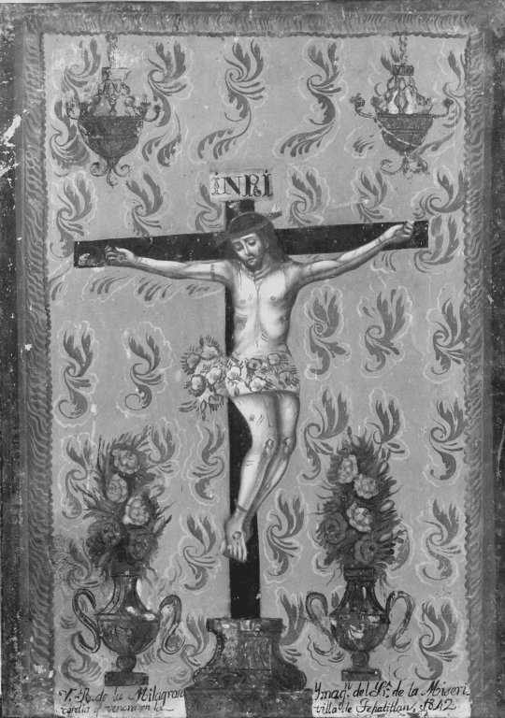
painting by Tepatitlan; courtesy of the Brooklyn Museum

